Slide 1

R Shiny for Building Web Applications
https://z.umn.edu/Rshiny
Sign-in:
Friday Oct 11, 9-12 AM
Learning & Environ. Sci (LES) Bldg. Room 230
Instructors & helpers: Alex Bajcz, Jessica Barry, Cody Hennessy
z.umn.edu/swc-signin
Notes:
Hi all, welcome to the first run of my SWC-inspired course on R Shiny for building web apps.
-I’m Dr. Alex Bajcz, designer and instructor, joined by Jessica Barry and Cody Hennessy as helpers.
-Today’s course is a shortened version of the lesson available at this URL.
-Before we start, please sign in to the workshop using this QR code or URL so we know you’re here.

Slide 2
Carpentries Code of Conduct
Use welcoming, inclusive language.
Be respectful of differing viewpoints and lived experiences.
Accept constructive criticism gracefully.
Focus on what’s best for learning.
Show everyone courtesy and respect.
https://z.umn.edu/ccoc
Notes:
A reminder: By being here today, you’re agreeing to abiding by the Carpentries Code of Conduct—basically, inclusivity and respect for all and for the learning environment.

Slide 3
Workshop overview
Intention: Cover web development basics and project setup (Hour 1), Shiny core concepts (Hour 2), and complex interactive elements (Hour 3).
…But we’ll get to what we get to! We’ll take 5-minute breaks at 9:55 and 10:55 and end at 12:00 no matter what.
With the exception of some of the first hour, this’ll be a live-coding workshop—we’ll code together in real time!
Ask questions!!!
Raise your hand, put a post-it on your laptop, or wave down a helper.
Restrooms:
Notes:
-A brief overview of where we’re headed over the next 3 hours:
-First hour covers project setup as well as web dev basics. 2nd hour covers R Shiny’s core concepts. 3rd covers the real fun stuff: complex elements like maps, tables, and figures.
-Will we get to it all? We’ll find out lol. Either way, there’ll be 2 five-ish minute breaks before each hour and we’ll officially end at noon. Anything we don’t get to, you can explore on your own using the online curriculum.
-Except for much of hour 1, which’ll be majority PPT, this is a live-coding workshop. I’ll be coding and expect you all to code alongside me the whole way.
-As I go, please stop me and ask questions! Raise your hand, flag down a helper, throw stuff at me—however you can get my attention.
-Lastly, if you need restrooms, they’re out there. Feel free to leave to use them at any time.

Slide 4
Installation / set-up
This course assumes you’ve downloaded and installed R and RStudio.
If you haven’t, raise your hand!
Please install the packages we’l use today now:
install.packages(c("shiny", "dplyr", "ggplot2", "leaflet",
"DT", "plotly", "gapminder", "sf"))
Previous R+RStudio experience is assumed—this workshop won’t cover any introductory R content!
However, no previous Shiny or web development experience is assumed—our goal is to take everyone from “web 0 to web hero!”
Open the online curriculum: https://z.umn.edu/Rshiny
Notes:
-Now, as the setup instructions said, we’re assuming you’ve already installed R, RStudio, and the packages we’ll use. If you haven’t, do so now.
-Also note this isn’t an intro R course. It’s for comfortable R users. If you have R questions, I’ll ask you reserve them for breaks or for the helpers.
-Meanwhile, no web dev or shiny experience is assumed. So, if you want to use R the R you already know to get onto the web, you’re in the right place!
-Does anyone have any questions?
-Lastly, I ask that you all open this course’s online curriculum now, if you haven’t, using this link. There’ll be times you may find it easier to copy-paste rather than long code, and you can find all the code for this workshop in the curriculum.

Slide 5
Some apps to inspire you!
Notes:
Here, show app we’re building. Not super pretty, but highly functional, and you’ll understand how to make it prettier.
Then, show PI Charter: z.umn.edu/PICharter. Shows what’s possible—really complex, lots of features, 2 year dev, publication, dozens of partners. 95% of what it does is what I teach here! So, if you master this content, you can build something really sophisticated.

Slide 6
Hour 1: Welcome to the web!
What we’ll cover:
Web Development 101
How a website actually works.
How websites are built (frameworks).
Where Shiny fits in.
Set up a generic Shiny Project folder
The very basics of HTML and CSS
Notes:
So, let’s jump in by starting with a birds-eye view of the web—how websites work (vs. how we think they work), how they’re built, and how Shiny fits in.
We’ll get into R a bit to set up a generic Shiny Project also.
And we’ll see why learning some basic HTML and CSS will be helpful.

Slide 7
What’s a website?
Shiny is for building websites.
How’d you describe what a website is??
“A place out on the internet you go to or ‘visit.’”
“A 24/7 interactive TV channel you tune into.”
“A digital magazine that ‘flips its pages’ as I interact with it.”
These descriptions aren’t very accurate!
Notes:
Let’s start with this question: How’d you describe what a website even is? Like, what is Amazon.com? What happens when you go there?
After all, Shiny is a website-building tool, so we ought to really understand what it helps us build!
Here’re some ways one might describe a website…
If these feel relatable, I’ve got news—none of these are accurate!

Slide 8
What’s a website really?
The half you see is just that—a half.
UI (user interface) / “client side”:
Your browser requests a bunch of code from a distant server.
Your browser executes it to build an app (website) on your computer!
Server / “back end”:
A computer somewhere fields requests, provides new instructions, and performs sensitive or complicated operations.
Websites live on your computer!
Websites are “dialogues” between your browser and a server based on your actions and the programmers’ code.
Notes:
So what’s a website, really?
Well, first, a website is not one thing but two. The half you see is called the UI or user interface or “client side” (you’re the client/user here).
This part is an application, not unlike Powerpoint or R, running live in your browser, built using code files sent to your computer, upon your request, by a distant computer. You went to a URL, your browser said, “Hey server, gimme stuff! And that server said ok, here you go. Your browser read that code and BUILT Amazon.com, from scratch, on YOUR COMPUTER.
So, Amazon.com, so far as you’re concerned, is as much ON YOUR COMPUTER at that moment as it is “somewhere else!” Trippy!
Or course, there is still that elsewhere—website also have a server or back-end half. This is a computer we call a server fielding those requests. It’s also doing operations not practical or safe to do on a user’s computer, such as access passwords, scan for malware, crunch big data, etc.
So, a server controls what you get sent, but it’s your browser that actually builds and runs a website. The web lives on your computer! Which is why the internet was such an easy way to get computer viruses back in the day.
A website visit is a dialogue of files and data between our browser and a server. You request stuff and click stuff and the server responds with new files and instructions that change the app you see.

Slide 9
How is a website built?
Similarly, in two halves.
UI:
HTML (HyperText Markup Language) – Structural. What goes where?
CSS (Cascading Style Sheets) – Aesthetic. How does it look?
JS (JavaScript) – Behavioral. What’s it do?
Server:
SQL (Structured Query Language) – How to store/retrieve data?
PHP, Python, Ruby, JS, C#, etc. – Operational. How are complex requests met and jobs done?
You might need 5+ languages (including 2+ scripting languages) to build one website!
…or do you??
Notes:
Logically, then, websites are also built in two halves. This is generalizing, because there’re lotsa ways to build websites, but classically, here’s how you’d do it.
For the UI assembled by your browser, web developers would write code in three languages.
To dictate what goes where, they’d write HTML. To dictate how that stuff looks to you, they’d write CSS. To code behaviors of the app, like what happens when you press buttons, they’d write JS.
On the server side, developers have more options but, typically, they’d use a form of SQL to do data reading, writing, and manipulating, and, for everything else, they’d use one or more general scripting languages, like PHP, JS, Python, Ruby, or C#.
If you’re counting, a web developer might need to code in 5+ different languages, including 1-2+ scripting languages, to build one website! Yikes. No wonder us researchers rarely build websites!
Or do they?

Slide 10
R Shiny to the rescue!
R Shiny is a framework—all that’s needed to build both halves of a website.
Primarily, R serves as the one in-control server language.
Shiny, meanwhile…
Replaces HTML with “R-like” code to build the UI.
Replaces JS with “R-like” code to handle user interactions.
Applies very basic CSS and allows for adding more.
Coordinates the dialogue between the server and users’ browsers.
Notes:
Cuz, in recent years, we’ve seen many frameworks emerge, including Shiny. A framework is a complete toolset for building both halves of a website.
In Shiny, R serves as the one server language, cuz it’s a scripting language that also excels at wrangling data, making visualizations, and being a “scoreboard/tracker”. It can even do SQL work!
Meanwhile, Shiny code—the part that’ll be new to you all--does the rest thru what I call “R-like code.”
To structure your app’s U, you’ll write Shiny code, not pure HTML. To respond to user actions, you’ll write Shiny code, not pure JS. Shiny also tries to replace the need to write any pure CSS, though, here, it fails noticeably!
Shiny, or Shiny Server, really, also serves as “switchboard operator” between users’ browsers and your server so dialogues take place successfully.

Slide 11
Why Shiny?
*A few caveats …
Shiny abstracts away HTML and JS but doesn’t do that to CSS.
If you want your apps to look nice, you’ll want to learn to use some CSS.
Shiny abstracts away JS but there’re things JS can do Shiny can’t.
If you want more advanced features, you’ll want to add a little JS.
While it looks “R-like,” R Shiny code may still feel unfamiliar.
Shiny UI code is basically HTML.
Shiny server code evaluates differently than R code cuz it’s basically JS still (by necessity).
With R + R Shiny, R users can bring their work to the web without learning as many* languages!
This means direct stakeholder engagement, dynamics graphics, distributed data collection, decision dashboards, and so much more!
Notes:
So, if you know R and can add Shiny to your repertoire, you can get your research on the web without needing to learn 5 new languages! More like half of 1, or 1, or maybe 2.
This means putting your research in your stakeholders’s hands by building dynamic, interactive graphics to display your data in exciting ways, and letting stakeholders explore them on their own terms.
You can also collect and process data in real time and provide decision support dashboards to help your stakeholders. And so much more! Anything a website or app can do, Shiny lets you build! However, there’re a few catches:
First, Shiny gives you the option to write “R-like” code in place of HTML or JS, but it doesn’t for CSS in many instances. Without learning some CSS, your apps’ll work but look super bland. That’s why we’ll do a quick CSS crash course in a bit!
Second, Shiny doesn’t port all of JS’s functionality—there’re cool things JS can do Shiny can’t. I won’t cover those, but trust me, they exist! Knowing a little JS and how to add it to your app can make your apps a lot cooler.
Lastly, all this “R-like” code I’ve mentioned may look like R code, but it probably won’t feel much like it. And the reason is simple: it’s not really R code!
On the UI side, you’re basically still writing HTML, just in R’s clothing. So, knowing a little HTML goes a long way toward making Shiny’s UI code more intuitive, which is why we’ll also do a quick HTML crash course in a bit!
On the server side, you’ll basically be writing some JS, but in R’s clothing. Importantly, this Shiny code evaluates differently than the R code you’re used to—we’ll have to talk about that in the second hour :).

Slide 12
Setting up our app’s project folder
Notes:
So, that’s web development in a nutshell and how Shiny fits in and changes the game. Any questions so far?
Next, let’s palette-cleanse by getting into RStudio to get our app off the ground. Let’s establish all the files and folders I recommend you make whenever you start a Shiny project.

Slide 13


server.R
styles.css
ui.R
behaviors.js
global.R
Font files, media files, etc.
*.Rproj
Root
www
Custom scripts
Rcode
“Module” files
inputs
Data files
Notes:
We’ll first build a folder I’ll call our root folder. It’ll hold every other file our app needs.
Inside it, we’ll make three R Script files named EXACTLY ui.R, server.R, and global.R. Yes, those exact names are meaningful, so use them!
Then, we’ll make a subfolder called EXACTLY www. Inside it, we’ll add a file called styles.css.
Lastly, we’ll make our root folder into an R Project folder so it get a .Rproj file. How many here are already familiar with R Projects? They make it easier to work on complex, long-term projects—they keep your packages organized, help you retain your environment between sessions, and keep your files open between sessions too, among other features! So, they’re really great for Shiny app projects.
(Do all those things)
Before I move on, note that I usually build more stuff at this stage than we’ll use today. For example, if you want a file for custom JS code, or to use custom fonts, or to include media like videos, all that stuff goes in the www folder because R will assume it’s there!
I also really like to subdivide my app’s code into chunks so it’s easier to find just the code I want to work on. I use an Rcode subfolder to keep all those separate code files in one place.
And if my app has inputs, like data sets or R objects, I put those in a separate inputs subfolder.
So this is the minimum structure I recommend for every Shiny app project.

Slide 14
global.R
First to run when the app starts.
Should set up everything other app files need.
Add any code that only needs to run once.
Prebuild/Preload assets your app would otherwise need to make/load “on the fly.”
At a minimum, include:
library() calls.
Data-reading commands.
Notes:
Now we can add code to our app’s main files to get to where the app would start.
We’ll start with global.R, which is the first file to run when an app starts. Its job is to set the table for every other file in our app.
So, we should put anything the app needs upfront or would need to make only once into global.R.
Good examples include library calls to turn on packages and commands that read in necessary inputs.
Both those things apply to us…(Go to R and do).
If you can pre-build anything assets your app needs but would otherwise have to make on the fly and stick it in global.R, that’s a good practice! It keeps your other code files tidier and may make your app faster too.

Slide 15
server.R
Contains all code that’ll run server side.
Creates all complex UI elements.
Contains code that watches for and responds to user actions.
Performs all back-end data operations
Should produce a single function named server:
server = function(input, output, session) {
#ALL OTHER SERVER-SIDE CODE GOES IN HERE.
}
Notes:
Next, let’s talk server.R. This’ll contain all code that runs on the server side to handle user interactions, to build complex visual elements for our users’ UI, and perform data operations.
For a typical, complex Shiny app, your server code’ll be ~70-95% of all your code! So, keeping this file organized is essential.
Remarkably, though, it actually must only contain a single command—one creating a custom function called server with three parameters named exactly input, output, and session.
ALL other server code’ll go inside this—the server is the “doing things” part of a website, so it makes sense it is one giant verb!
(Go to R to do)

Slide 16
ui.R
Builds the UI.
Links in any additional files a user’s browser should use when constructing the UI.
Produce a single R object named ui that’s an HTML container:
ui = fluidPage(
#ALL OUR CLIENT-SIDE CODE GOES IN HERE
)
Notes:
Lastly, there’s ui.R, which builds the instructions sent to users’ browsers to construct our website’s UI.
Even though a website may contain hundreds or thousands of elements, our ui.R file is also contains just a single command---one that produces an R object called exactly ui.
This object needs to be an HTML container of some kind—I will explain what that means in a few minutes.
But, for example, in our case, our ui.R file will contain a single call to a function called fluidPage(), with the result stored in an object called ui. All other UI code we’ll write will go inside this call.
(Go to R to do. Show that the app runs now.)

Slide 17
HTML 101
Notes:
We just started up our app and, lo and behold, it’s VERY boring—an empty white screen!
We need to put elements in our UI if we want to change that. To do so, we’ll need to learn a little HTML, the language used to build the structure of UIs.

Slide 18
Why bother with HTML?
The first and most critical step of building a Shiny app is designing the UI.
I’d like to jump straight into it, but we shouldn’t.
In practice, writing Shiny UI code is not much different from writing HTML.
As such, knowing a little HTML’ll make writing Shiny UI code a lot easier!
Notes:
It’s important we cover these topics for many reasons, but the main one is that, in my opinion, the first and most important step of building a Shiny app is drawing out, often literally, how you want your app to look.
What fixtures exist? Where are they on the screen? What can users do? What is your webpage’s layout? As with any project, if you don’t know what you’re trying to create, you’ll struggle to make it!
So, as much as I’d love to jump straight into building our app’s UI for our app, we can’t.
I think you’d struggle if we did! Shiny UI code looks like R code, but it’s really just HTML wearing an R hat!
So, if we learn a little about HTML and web design, the UI code we’ll build will make more sense (I hope.

Slide 19
HTML in just three concepts
Good news: HTML is not a scripting language but a markup one.
All it does is tell browsers what elements to make and where to put them.
Three key ideas of HTML and web design:
A webpage is just a box containing other boxes and/or stuff. These boxes are HTML’s nouns, called elements.
Every webpage has a head box for special instructions and a body box for the stuff users see.
HTML boxes have modifiable attributes (“adjectives”) that can distinguish them from each other and also properties that affect how they looks and “fit together” on different browsers, screens, etc.
Notes:
Now, thankfully, HTML is NOT a general programming language, like R. It’s got a very narrow job and thus a narrow set of words and rules.
Its job is to help a browser know what to build and where to build it—that’s it!
In fact, HTML stands for hypertext markup language, and “markup” fits because it’s more like Markdown than R, if you’re familiar with Markdown.
Rather than a general language, it’s a coded set of instructions for how to build something rather than perform tasks.
I think Shiny developers should know just three things about HTML and web design more generally:
First, a website’s UI is just a box filled with other boxes. Those boxes either hold fixtures you’d recognize, like text blocks or images, or they hold other boxes. All these boxes are HTML’s “nouns,” called “elements.”
Second, two boxes that exist on every website are the “head” box and the “body” box. Virtually everything users see goes in the body box. However, special instructions on how to build a site, like what CSS to use, goes in the head box.
So, almost all we’ll do as Shiny users is fill the body box. But occasionally we’ll need to put something in the head box—we’ll see how later.
Lastly, HTML boxes have changeable attributes (HTML’s adjectives) that distinguish them from each other. They also have properties that affect how they behave and “fit together” and look depending on screen size, browser brand, and so on.
These are abstract ideas, so let’s go deeper into each.

Slide 20

All the world’s a box
When you look at the website to the right, what do you see?
Notes:
Let’s start with that first concept: that websites are just boxes full of stuff and other boxes.
Here’s my MyU landing page from a while back. When you look at it, what do you see?

Slide 21
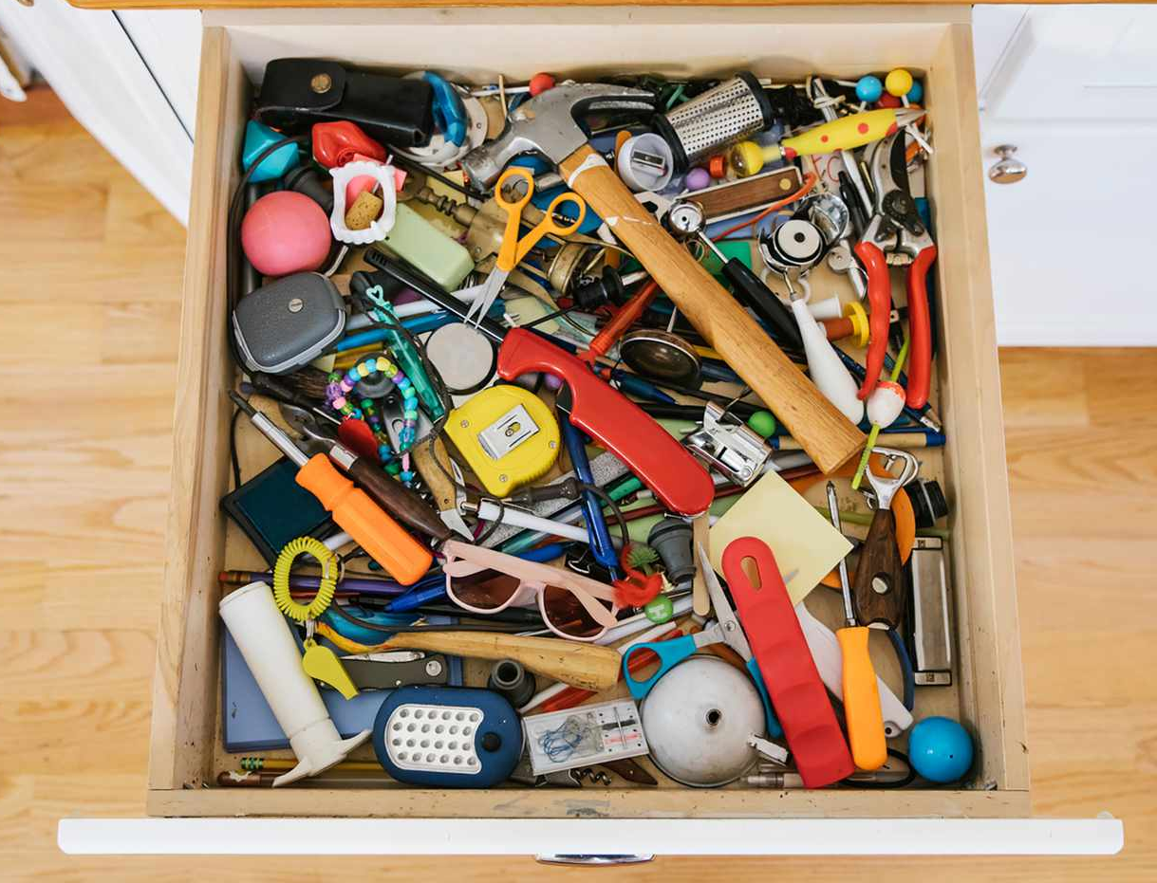
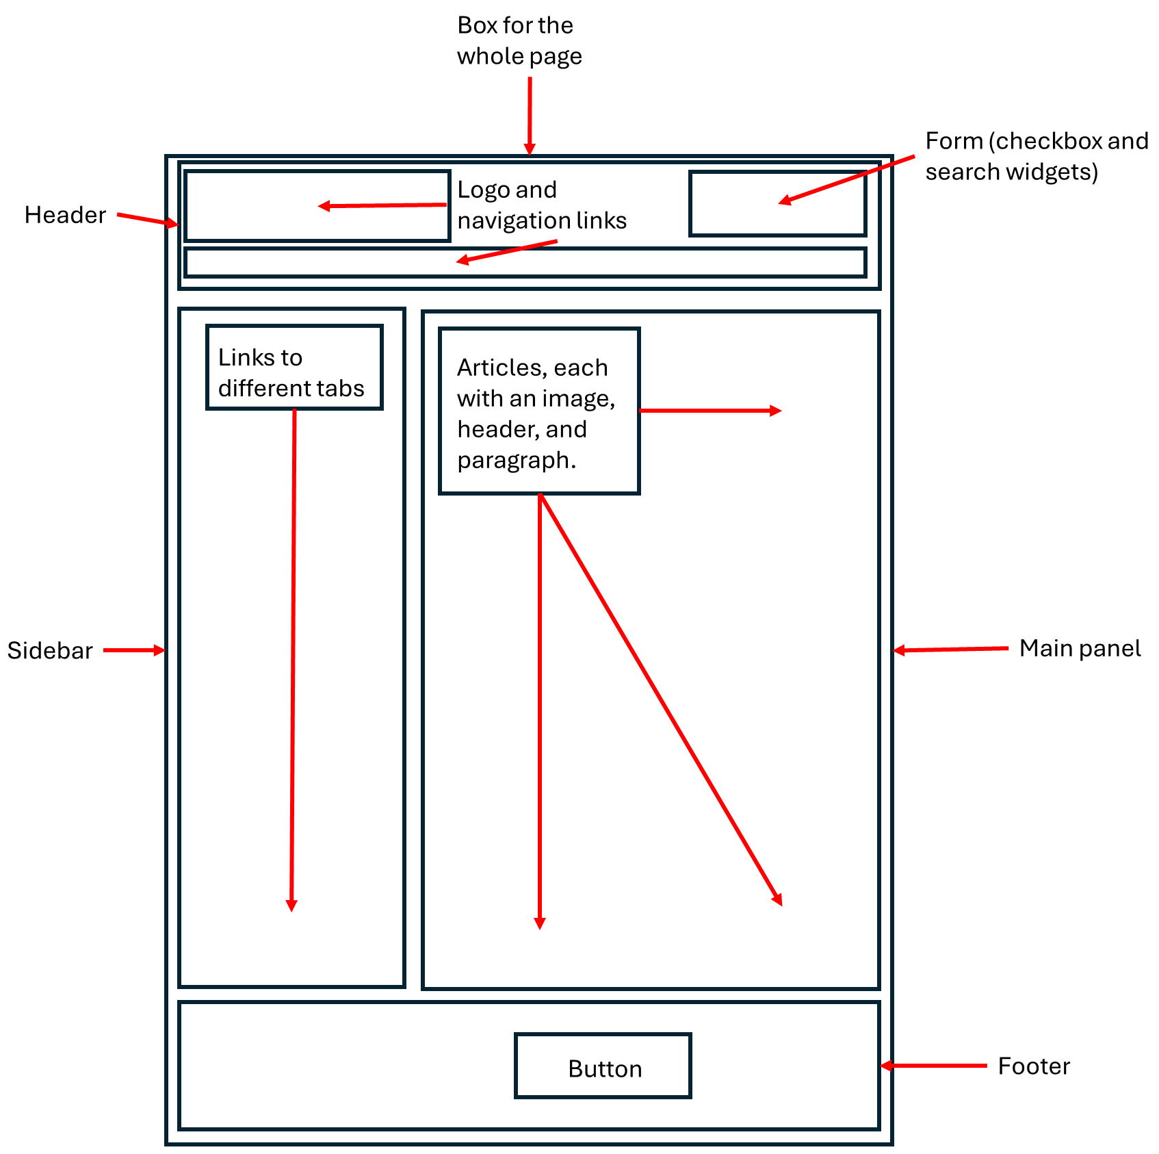
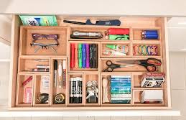
All the world’s a nested box
I want you to envision a webpage like this: As a nested set of boxes holding stuff and other boxes.
Notes:
What I want you to see, when you look at any webpage like this one, is what a web developer sees, which is something more like this:
There’s one box holding the whole page, and it contains three boxes—a header, a footer, and a main area. The header has a box for a form which contains widgets like a search bar, a box for a logo image, and a box for a navigation bar.
The main area box contains a sidebar box and a main panel box, with the main panel box is divided into article boxes each containing headers, images, and text blocks. And so on!
The point is to think about a webpage as less of “one area” like a disorganized junk drawer and more like a carefully mapped series of cubbies and slots, like those created by a drawer organizer.

Slide 22
Codeword: div
Here’s the code for an HTML div (short for “division,” a generic box):
<div id = "my_box">
My box's contents </div>
An opening tag --> <div>
A closing tag --> </div>
In between --> the box’s contents:
Inside the opening tag, set attributes using attribute = “value” format.
In Shiny, we’d make the same div using R-like Shiny code:
div(id = "my box",
"My box's contents“
)
Hopefully, you see this is hardly different from writing HTML!
Notes:
So let’s see what an HTML “box” looks like at a coding level so we can appreciate how we’d use them to build an orderly arrangement of content on a page.
Here’s the code for a division, or div for short, which is a generic HTML box.
First, you’ve got an opening tag, the element type name (here, div) surrounded by carrots.
Then, there’s a closing tag, which is the same but with a backslash before the name. These two tags tell a browser where a box “begins” and “ends.”
In between, we put the box’s contents. Here, that’s text, but it could be hundreds of other things, including other HTML boxes.
Inside the opening tag, we can also modify attributes to using attribute = quoted value format. Here, we gave our box an ID of “my_box.” HTML ids must be unique, so this one would distinguish this box from every other in our entire webpage. We’ll see why that matters later.
Now, I argued earlier that, in Shiny, when coding our UI, we’re basically writing HTML code with an R flair.
To prove my point, here’s how you’d code the same box using Shiny code.
Ok, yeah, it’s R syntax—this looks like a typical R function call with typical input structure. But, hopefully, you see this is not much different from the HTML it’s replacing!

Slide 23
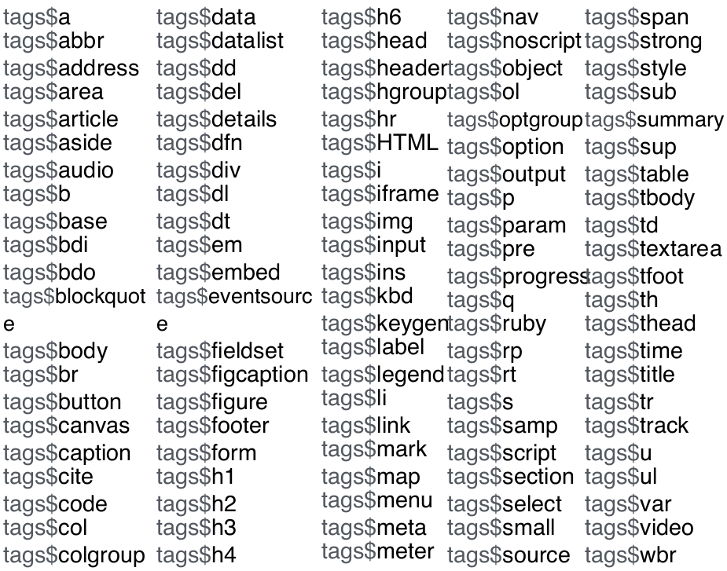
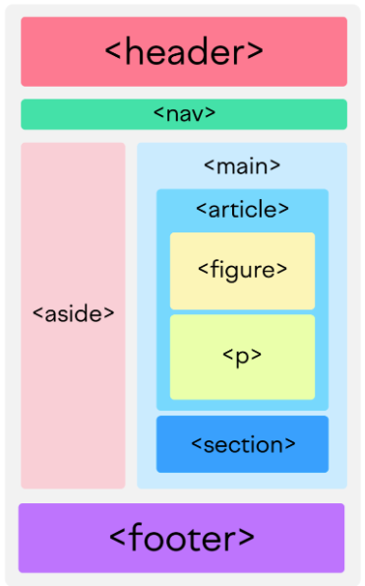
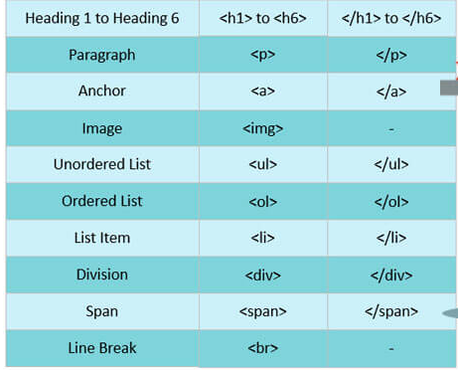
You get a box, and you get a box, and…
Notes:
divs are a catch-all box web devs use a lot, but they’re by no means the only box! There are hundreds of HTML box types out there, although a couple dozen are used far more often than others.
If you’re familiar with Markdown, some of these may be familiar: You have boxes for headings (h1, h2, etc.), text boxes (called paragraphs, or ps), anchors (what we’d call “links”, or as), images (img), numbered and bulleted lists (ol and ul) and their list items (lis), and so on. There are also “descriptive” boxes for things like headers and footers, sidebars, navigation bars, page sections, figures and figure captions, and so on.
Here are just some of the HTML boxes you can add to your Shiny apps using Shiny’s tags functions.
So, if you can add it to a website in Wix or Squarespace, or to a report in Markdown, or maybe even to a document in Word, you can probably add it to a website in Shiny!

Slide 24
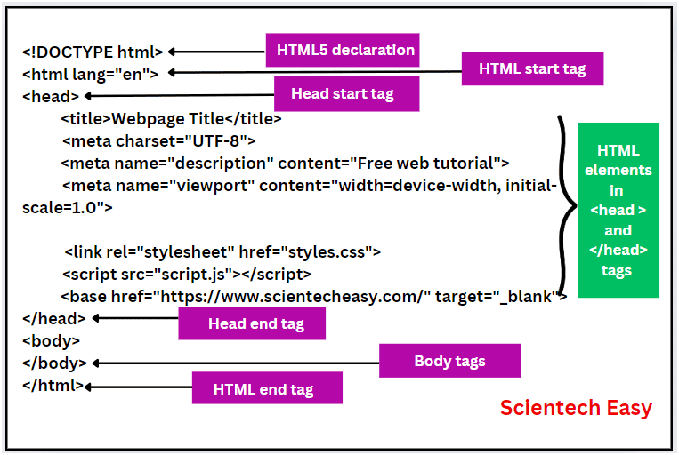
The head and the heart
Every webpage has an <html> box containing two boxes: the head and the body.
With one exception (the <title>), everything the user sees goes in the body. Shiny assumes all UI code goes there unless otherwise specified.
An exception: Linking to a CSS file:
tags$head(
tags$link(
href = "styles.css",
rel = "stylesheet“
) )
Notes:
Next, I mentioned that every website’s UI is a box (an HTML box) that contains two boxes—a head and a body.
In Shiny, the HTML box is created for us invisibly—we can’t see it, touch it, or make it. That’s fine cuz we don’t want or need to!
The head and body boxes are also created for us invisibly. Everything we put inside the ui object will automatically get put into the body unless we explicitly say otherwise.
So, 98%+ of our UI code, and what our users will see, will be body box code.
However, there are two exceptions worth mentioning.
First, the head box can contain a title box. It’s optional but kinda fun! Let’s see what it does—(Show in R)
Second, I mentioned earlier the head box is for special instructions browsers should use when building our app. That includes references to other files the browser should reference when building our app besides the HTML one it reads first, such as any CSS style sheet files. Let’s reference the CSS file we’ve made in our own app by putting a reference to it in the head box manually—(Show in R).
Adding that CSS file reference doesn’t do anything yet cuz that file is empty! But not for long…
Note that, you’d link to any JS files in a similar manner, using a “script” box instead of a “link” box.

Slide 25
CSS and web design 101
Notes:
Adding our stylesheet is a nice segue to the last section of this unit—where we’ll start adding real structure to our app in a way that’ll look nice on a range of devices.

Slide 26
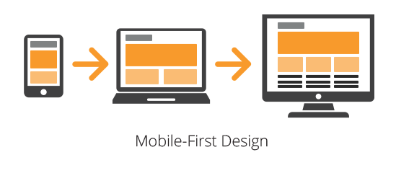
The 21st Century Challenge
One challenge of 21st Century web design: Users use a range of devices.
From smart watches to projectors!
Several different browsers and OSs!
Must guide the selection of elements & their “flow” on narrow/wide screens.
One paradigm: Mobile-first design.
Order all elements logically and stack them vertically, giving each max screen width.
Then, re-arrange some into a grid/table or “paneled” layout if the screen width allows.
Notes:
In fact, making a website that looks good on a range of devices is what I think of as the challenge for 21st Century web developers.
Consider that users might access your app on a variety of devices. Not just with different operating systems of different versions and ages but vastly different sizes and resolutions too. Anything from a smart watch or flip phone to a projector screen or jumbotron. Any web-enabled device could try to view your website!
When we’re designing a webpage, then, we need to consider not just what elements to include but how these should display, or “flow,” on screens of various sizes.
One paradigm for this is called mobile-first design. In MFD, you design your website such that, on a narrow screen, like a phone in portrait mode, everything arranges into a single vertical column.
However, you set up the UI to be flexible such that some elements might panel or grid next to each other if screen width allows, allowing more things to be on screen at once when that’s possible. This is often easier than trying to figure out how to cram a complex arrangement into a single column!
We’ll use MFD to make our app today, and Shiny’s tools make that easy!

Slide 27
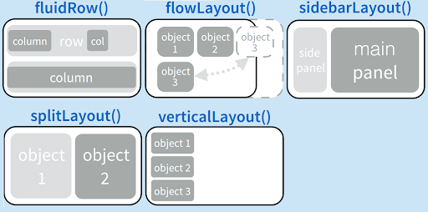
Shiny goes with the flow
Shiny’s custom HTML boxes include fluid*() functions like fluidPage() and fluidRow() .
These expand/contract to fit contents.
They divide your page into “tables” of rows and columns that stack or slot side-by-side automatically according to screen width.
Shiny’s custom HTML boxes also include *Layout() functions like splitLayout().
These force certain layouts regardless of the screen size.
Notes:
It provides some special HTML containers for this, including the fluid*() series containers.
Today, we’ll use a fluidPage container as our outermost container. This ‘ll automatically expand or contract in size according to the contents objects we place directly inside it. It’s basically the Spanx of containers.
We then subdivide that page box into rows, using fluidRow(), and those rows into cells using column(). This creates a “grid-like” tabular structure, in which elements that would stack vertically by default will instead sit side-by-side if there’s room and in which elements that would sit side-by-side by default will instead stack vertically if there isn’t room. That handles both halves of the MFD paradigm!
Meanwhile, Shiny also has the “layout*() family containers, which do the opposite—they force a certain layout, regardless of screen size. So, for example a sidebarLayout would have two columns (a narrower side panel and a wider main panel) even on a smart phone.
Instead of using that, we’ll use the fluid functions to build something that automatically looks like that on wide screens but looks like a single column on narrow ones.

Slide 28
Jump-starting our UI!
Let’s add some basic structure to our app:
A header using h1()
One fluidRow() divided into two cells via column()s:
A side panel (1/3rd of screen width) and a main panel (2/3rds of screen width) for a “sidebar layout” on wide screens.
On narrow screens, the side panel will shift to first, with the main panel below it. That’s automatic mobile-first design!
A footer().
Notes:
Now that we know what UI elements we want to use, where they come from, and why we want to use them, let’s *finally* do some earnest Shiny coding by adding some UI elements.
We’ll first make a header-like box containing a title for our app using the top-level heading HTML element, h1.
Then, let’s add a single fluidRow, which we’ll divide into two cells using the column() Shiny box. We’ll set the columns’ widths to 4 and 8, respectively. That’ll make the cells take up 1/3 and 2/3rds of the screen width, respectively, just like in a typical a sidebar layout which is what our app’ll look like on a wide screen.
On narrow screens, because we add the side panel “first,” the side panel will shift automatically to sit above the main panel cell, so users will see it first. Since it’ll contain options for messing with our main panel’s content, this order makes sense to me.
Lastly, we’ll add a footer using the footer() Shiny container.
(Go do this in R, and then start the app to show—remind them at this point to switch to “launch external”!!!)

Slide 29
Why CSS?
…The app looks dull…Shiny’s default CSS is very bland!
If we want our app to be pretty, we must add some CSS code.
CSS is also not a scripting language. All it does is tell a browser how to display each UI box or contents.
Color, font, border, size, animation, alignment, etc.
Notes:
We just saw that our app looks quite dull! And not just because there’s not much in it. I said earlier that the default CSS Shiny applies is SUPER basic.
If you want your app to be pretty, learning some CSS code is essential.
The good news is that CSS is also not a scripting language! Its only job is tell a browser how to display each element—what colors, fonts, borders, sizes, animations, alignments, etc. to use.
In that way, it’s more akin to theme and the scale functions in ggplot2 than to R. What are we changing, and what are we changing it to? That’s it.
So, you CAN definitely learn enough CSS to make a BIG difference, I promise!

Slide 30
The Rules of CSS
CSS’s commands are called rules. Rules have two parts:
Selector
This targets (or selects) one or more elements for styling.
Declaration block (inside of braces { })
This contains one or more properties to change and a new value to set for each property, using property: value; format.
Notes:
So here are the absolute basics every Shiny developer should know about writing CSS code.
CSS commands are called rules, and they have two parts. The first is called a selector because it selects the element(s) we want to style.
The second is the declaration block, or block for short, and it’s placed within braces {}.
Inside the block is a list of properties and values written in pairs—the properties are the characteristics we want to change, and the values are what we want to set those properties to.
These list items follow a specific format—property name, colon, value, semi-colon. Get the punctuation or syntax wrong, and the rule won’t work!

Slide 31
Example CSS rule:
Note CSS’s punctuation!
h1 {
color: darkblue;
font-size: 24px;
text-align: center;
margin-top: 20px;
font-family: Arial;
}
Many CSS values take units.
CSS property names follow kebab-case.
Text values aren’t quoted.
Notes:
This’ll all be clearer with an example. Here, in this rule, our selector is “h1”—we’re targeting ALL h1 headings in our entire app, all at once. If it’s an h1, we’re pointing at it.
Then, we start our block. Inside the braces, we have 5 properties listed on the left of the colons, and one new value for each properties on the right.
Specifically, we’re setting the font color to darkblue, the font size to 24 pixels, vertically centering the text, adding an empty buffer of 20px to the top, and making the text Arial.
For beginners, the number one thing is to pay attention to the punctuation. CSS is very fussy about it and, if you mess it up, you won’t get the desired effect.
Also, notice that CSS properties follow kebab-case…hyphens “skewer” all the words :).
Lastly, note that CSS does not quote text values like languages like R do.

Slide 32
A bit more on selectors…
To target all elements of a type, use the element name:
h1 {…}
To target one specific element, give it an id, then use that id + a #:
#my_title {...}
To target a group of elements, give them a shared class, then use that class + a .:
.all_titles {...}
To target more than one target in the same selector, separate them with commas:
#my_title, .all_titles {...}
Notes:
A lot of learning CSS is just learning the names of the properties you want to change and what the new values need to be. ChatGPT, W3school, and your browser’s development tools are all good ways to expand your CSS vocabulary—I’ll show you the last of these in a second.
However, it’s also important to be able to write selectors that correctly target the elements you want to modify. You can get far in this regard knowing just three types of selectors.
First, as we just saw, you can target all elements of a type by using that type’s name and that’s it, such as h1 or p or div.
If instead you want to target just a single, specific element, you can use that element’s id attribute and a #, such as #my_title. This is why it’s essential to know that boxes can have ids and how to set them—it allows us to style them carefully.
Those are the two extremes, but, sometimes, you want a middle option: to target several elements as a group, maybe including a mix of element types. In that case, give all those elements a class attribute they share and use that class plus a dot, like .all_titles. You add class attributes the same way you add ids.
Lastly, you can put multiple targets in the same selector if you separate them with commas, as shown here.
Now, of course, CSS rules can get more complicated, but what I’ve covered here would get you pretty far.

Slide 33
A little vanilla
Our title is drab—let’s jazz it up by making it bold and green.
Here’s what we’ll add to our styles.css:
#header {
color: green;
font-weight: bold;
}
Notes:
Turning back to our app, we can start to address the blandness by applying the CSS concepts we just learned to spruce up our title by making it green and bold.
To do that, we’ll add the following CSS rule to our styles.css file (go do this—run and see!)
(Give them the option to adjust one other feature to show them how to find the property name and value on w3school).

Slide 34
Tools of the trade
“What selector should I use? Why isn’t my CSS working? How could I “tinker” with my app’s design?” How do I discover what CSS is possible?
First: Make sure your browser is not using old CSS by doing a hard refresh (control+F5 on PCs)!
All these questions and more can be answered using your browser’s developer’s tools.
Notes:
Now, you might be thinking…but how do I know what selector to use, if it’s not obvious? Or what do I do if my CSS isn’t working? Or is there a way to find cool CSS ideas on other websites and use them in mine? Or can I tinker with my CSS to see what settings I might want?
First, if your CSS isn’t working, it can be because your browser has stored, or cached, old CSS and is using that old CSS instead of your new stuff. As such, I recommend you first try do a hard refresh of your app using control+f5. That sometimes helps!
Otherwise, all these questions can be explored using your browser’s developer’s tools.
Opening this is different on every browser. On Edge, it’s easy--you just right click and hit “Inspect.”
What you get is an intimidating screen! But really useful. On the left is all the HTML Shiny for our app. On the right is all the CSS for the element we’re looking at, including some CSS Shiny has put in by default.
You can use the developers tools to see how your HTML elements are nested and what attributes they have.
You can also see which CSS properties are being set for each element. You can also see why some properties or rules aren’t maybe working as intended.
For example, crossed-out properties aren’t active; when two rules conflict, one wins and the other gets crossed out to show that. Orange properties are those with invalid values or properties, such as when we make a typo (show both situations)
You can check or uncheck properties to see what difference they make, or enter new properties to “demo” them! It’s a great way to tinker and explore! You can do this on EVERY website you visit—they’re being built special for you on your OWN computer, after all, so you’re not breaking anything.
Lastly, if you ever want to know what selector to use to target any element in your app, you can right-click any element, hit copy, and then “copy selector” to add the right selector to your clipboard automatically!
Hopefully you can see why the developer’s tools is one of the most essential tools in every web dev’s arsenal!

Slide 35
Hour 2: Shiny Essentials
What we’ll cover:
Adding visual elements (a table)
Adding input widgets (a drop-down menu)
Events and event handling
Giving users control over events (a “go” button)
Giving ourselves control over events (an observer)
Adding a tab set
Notes:
That wraps up hour #1! We’ve covered web design and web development, we’ve made an R project that runs, and we’ve learned the essentials of HTML and CSS.
I know we haven’t actually done much in R but now that we have a really solid foundation, that can change!
We’ll spend the rest of our time in R and, in this hour, that’ll include learning all the essential concepts of Shiny itself.
We’ll cover how to add elements like tables to our UI, add input widgets like drop-down menus to give our users things to play with, and learn about events and how to handle them.
Then, we’ll give both users and ourselves more control over proceedings using a button and an observer, as well as add a set of tabs to our UI.
If the concepts in this hour click for you, you’ll possess a powerful toolkit that’ll allow you to build incredible apps!

Slide 36
Turning the tables
Apps are best when they let users do fun stuff.
Let’s start by displaying the gapminder data set in a table.
A table is just boxes within boxes—perfect for HTML!
…But let’s make R do the tedious task of building one.
To make a complex UI element in Shiny…
Do any “heavy lifting” with regular R code on the server side.
Render the R object server-side into the equivalent HTML boxes.
Pass that to the UI into a specific place by outputting it there.
Notes:
Our app is boring because apps are really best when they allow users to do cool things and they can’t with our app yet. So, let’s start adding cool things, starting with a way for users to see our gapminder data set.
If you think about it, a table is something HTML should excel at building—it’s just a box full of other boxes, i.e., rows, columns and cells.
And yes, you can build tables in HTML! But it’d be tedious to create a large HTML table ourselves. Thankfully, R will do it for us.
The process of having R build a large or complex UI element, like a table, and then actually place it in the UI involves three steps:
First, any heavy lifting, such data manipulation, needed to produce the R object we’ll use must happen.
Then, we render the R object, on the server side, into its equivalent HTML object. This is part of the magic of Shiny—we can create R objects and then use Shiny to simply “translate” them into their equivalent HTML!
Lastly, we pass the rendered element to the UI by outputting it. Let’s see all that in action: (Go show them).

Slide 37







Restaurant Shiny
Rendered HTML object = Cooked meal
R code inside render*({}) = Recipe
Final R object = Uncooked meal
render*({}) = Chef
output = Waiter
outputId = Order ticket
*Output() = Booth
Notes:
The code we just wrote had lots going on! But rendering and outputting are core ideas of Shiny, so let’s solidify our understanding of the processes with an analogy I like.
I want you to think of an app as a restaurant. In this analogy, the R code we put inside our render function’s braces is the recipe—how do we build an R object like what we want to display?
The final R object would then be the assembled meal. But it isn’t ready for customers—it’s not “cooked.”
We need the chef, our render function, to cook it into the final HTML meal that’s ready for customers.
Then, we need a waiter to physically carry that cooked meal out to our customers—that’s our output object.
Each rendered table needs to be carried to a specific spot in our UI—a specific booth. Each booth is marked by an Output*() function call.
But how do we know which rendered table goes with which tableOutput call? Well, the outputId we give each rendered table is like the order ticket—it tells us which food goes to which booth.
Does all this make any more sense?

Slide 38
Your input is requested
Our table looks drab, but, more importantly, it’s static—users can’t do anything with it except look at it.
Let’s allow users to interact with it—let’s add a drop-down-menu input widget.
This’ll allow users to decide which column the table is sorted by.
To set up an input widget in Shiny:
Build and place the widget in the UI using the appropriate Shiny function.
Pass the widget’s current value from the UI to the server using input.
Use that value inside a reactive context on the server side somehow.
Notes:
So, our table is present and functional in our UI now, if a little unexciting…we’ll fix that later. In the meantime, we can address its other shortcoming—it’s not interactive! We can’t actually do anything to it but look at it, as a user.
Let’s give users a way to interact with the table—controlling how it’s sorted—by adding an input widget.
A widget is any UI element that users can fiddle with and the app will track and maybe respond to those actions.
In this case, we’ll build a drop-down menu widget. To set up a widget in Shiny, we must do three things.
First, place the appropriate function in the UI to locate and build the widget.
Second, use the input object to pass the widget’s current value over to the server, where it can watch that value for any changes.
Lastly, use that current value in our server code somehow. Specifically, we have to use that value inside of a reactive context…None of this will make any sense yet but, slowly, it will!
Let’s start with step 1: Building the menu widget in the UI--(Go do, then run).

Slide 39
Selector connector
We gave selectInput() three inputs:
An inputId. A nickname used to slap this widget’s current value onto the input object and pass it to the server.
VERY like how outputIds are used to slap rendered outputs onto the output object to pass them to the UI ☺.
A label, text that describes what the widget does.
choices that populate the drop-down menu.
Notice our widget doesn’t do anything when played with…we need to add the corresponding server code!
Notes:
We saw, as we built our selectInput, that we had to give it three inputs.
The first was an inputId. Earlier, we met the output object. It was our waiter that carried our rendered table from the server to the UI using the outputId we created.
Now, we’ll meet input, which does the opposite--it carries to the server the current value of any widgets, using inputIds we create when we create widgets.
Second, we gave our widget a label, text that accompanies the widget and, usually, describes what it does.
Lastly, we gave the widget choices, which’ll be the options in the drop-down menu.
All other Shiny widgets, of which there are many, are very similar to selectInput, so it’s a good example.
Now, you’ll notice our widget doesn’t actually do anything—to fix that, we need to keep going and add the appropriate server code.
(Go do, then demonstrate it works).

Slide 40
Event planning
Event: Any action a user can take the app might track.
Ex: User selects a new choice for our widget.
Event handling: Executing code that “decides” how (or if) the app will react.
Ex: Our app acts to re-sort the table.
Reactive object: A value that might change at any time as a result of an event (rather than due to our code).
Ex: input$sorted_column, which will change whenever the user selects a new choice.
Reactive context: A code block Shiny knows might contain reactive objects.
Ex: renderTable’s expression (the braced part { … })
In general, braces ( { … } ) mark reactive contexts in Shiny server functions.
Key idea: Whenever a reactive object inside a reactive context changes, Shiny “handles” that event by re-running the entire reactive context.
The logic: If key inputs have changed, our outputs are “outdated” and need refreshing.
Notes:
Ok, now that we have a functioning input widget, we can talk about the most critical concepts in Shiny! So, let’s pause for some key terminology.
First, in web development, an event is any action a user takes the app *might* be watching for. In the case of our widget, an event is a user selecting a new choice in the widget.
Handling an event, meanwhile, is having code that’ll run to determine the app’s reaction to an event, if any. In our case, our app’s reaction is running code that resorts the original R object, then re-renders the table, then reOutputs it.
That brings us to the concept of reactivity. A reactive object is any object whose value might change as a result of an event—the user ultimately triggers the change, not us or our code.
An example is input$sorted_column. Its value changes every time the user selects a new choice in our widget.
A reactive context, then, is any server-side code block that might contain reactive objects like input$sorted_column and, thus, Shiny needs to be watch it for events.
In our case, renderTable’s expression, the part inside its braces, is a reactive context. It can contain values like input$sorted_column and R will watch it for events, aka any changes to those reactive objects.
In general, if a Shiny server function takes an expression in braces as an input, that expression is probably a reactive context, although we will see one exception later.
Here’s the key idea: Whenever a reactive object, like input$sorted_column changes inside of a reactive context, Shiny handles that event by rerunning the entire reactive context.
The logic actually makes sense. If a reactive context produces an output, like a table, and one or more inputs to that process have changed, our outputs are “outdated” and need refreshing, and the way to refresh them is to rerun the code making them, right?
(Demonstrate this fact using print(). Tell them this is also a great way to troubleshoot—when is code running? What are the values of things?)
(Also demonstrate that we cannot put reactive objects somewhere other than inside a reactive context.

Slide 41
Advance directive
In R, YOU’RE the user. R must meet YOUR needs NOW.
Imperative eval: “R, make me a sandwich, this way, ASAP!”
For a Shiny app, though, you’re not the user! Your users are whoever, with whatever needs, whenever.
We must anticipate their needs and plan to handle them!
Directive eval: “R, whenever someone comes and wants a sandwich, use these general instructions to make it using whatever inputs are around. Oh, and don’t do stuff unless and until it’s needed.”
Notes:
I said earlier Shiny server code might feel unfamiliar even though it looks like R code. I hope you’re seeing what I meant!
The reason is that our relationship with R is very different when we’re writing R code vs Shiny server code.
In R, we’re the user. We have needs, and we want R to meet those needs NOW.
R generally evaluates code imperatively for that reason, meaning it runs code from top to bottom, as fast as it can, as soon as we ask it to. It’s the equivalent of us yelling, R, make me a sandwich this exact way, pronto! and it responding yes sir!
But, when you’re writing Shiny server code, you have to realize you’re NOT the “user” anymore! Your needs are irrelevant. The users are whoever visits your app, and their needs could be whatever, whenever, in whatever order.
So, our job as programmers is to somehow anticipate these needs and plan to handle them appropriately.
In line with this, Shiny server code evaluates directively instead. That is to say it does nothing but watch for events until an event occurs, in which case it re-runs only whichever reactive contexts are affected, no matter where in our code those contexts are. It’s the equivalent of saying (read what’s on the slide).
Does this distinction make sense?

Slide 42
Button chops
Users may want control over when the table updates, especially if they have lots of widgets to fiddle with or if updates are slow.
Let’s give them a button widget—the table won’t update until it’s pressed.
How should we handle button presses?
We want button presses to trigger rebuilds, but new selections in our drop-down menu should not.
…But we still want to use the current menu selection to influence how the table rebuilds, when it does. Are we hosed?
This is a good time for isolation.
isolate() allows use of a reactive object’s value but prevents events.
Notes:
Now, you’ll notice we’re handling events related to our drop-down menu widget by forcing our table to be rebuilt every time.
This is ok here because we only have the one widget affecting the table, and rebuilding this table is fast.
But if we had lots of widgets, or if rebuilding the table was slow, a user might want more say in when the table rebuilds so that, e.g., they could dial in their selections before triggering the rebuild.
Let’s add a button widget to give them the power to say when rebuilding should happen.
(Go do it).
We have our button in our UI, but we still need to handle its events. Remember we have to use its current value inside a reactive context server side in some way to do that.
Here, we want button presses to trigger a table rebuild, so let’s add input$go_button to our renderTable({})’s reactive context to get R to start watching this object for changes in the same way it now watches input$sorted_column. (Go do that).
However, input$sorted_column is still there too, so changing the menu item also triggers rebuilds. We don’t want that! And we can’t just remove it because, if we did, we couldn’t use its value to influence how to sort the table. Are we stuck?
No. This is a time for isolation. The isolate function allows us to access a reactive object’s value for operations but prevents changes from becoming events. (Show them)

Slide 43
Observe and report
Isolation works well in simple situations…
When there are many reactive objects needing isolation, though, it’s clunky!
If we want to code a “if [this], then [that]” response, it’s cleaner to use observeEvent({},{}).
Notes:
This situation is pretty simple as these situations go—we have just two inputs, and we only needed to “silence” one reactive object with isolate to get the desired outcome.
If you have a more complex situation, like one requiring ton of isolating, there’s a cleaner option: observeEvent.
observeEvent allows us to apply a “if exactly this, do exactly that” response formula to events.
(Go do it).

Slide 44
Observe and report II
Note the app works the same; the two approaches are equivalent.
However, observeEvent({},{}) is more precise:
“Hey R, if {first expression} changes, do {second expression}. Never execute the first expression, and never trigger events in the second expression.”
It’s like expression 1 is on “mute,” and expression 2 is isolate()d!
Notes:
Notice the app works the same as before! These two approaches are functionally equivalent, but the second is more precise. It tells R, hey, listen for changes in this first expression and, when one happens, trigger the second expression.
“Oh, and also, never execute the first expression, and never trigger events within the second expression.”
It’s like the 1st expression is on “mute”—it can’t do work or make outputs; it can only trigger events.
Meanwhile, the 2nd expression is isolated—it can only do work and make outputs, NOT trigger events.
So, we can watch just one specific thing or set of things for changes and then use as many reactive objects in the response as we want without isolating them. Hopefully, you can see how this’d be useful!

Slide 45
Tabby cats
In the last hour, we’ll make an upgraded table and add a graph and map.
Let’s create spaces in our UI for these using a tabsetPanel to create three tabs inside our main panel cell, one for each new element.
Note the latter two tabs are empty, but not for long!
Notes:
At this point, we now understand the core concepts of rendering and outputting, events and event handling, widgets, and reactivity, so we have all the tools we need to build incredible apps!
In the last hour, we’ll upgrade our table and add interactive maps and graphs to our app. To keep our UI organized, though, let’s split the main panel cell of our app into three tabs using the Shiny functions tabsetPanel() and tabPanel().
(Go do that and show them).
Note that our latter two tabs are empty, but not for long!

Slide 46
Hour 3: Adding Showstoppers
For DT tables, leaflet maps, and plotly graphs, we’ll see…
How to add a default version to our app.
How to adjust/disable interactive features.
How to style them a little.
How to update them “on the fly” using a proxy.
How to treat them like widgets that can trigger events.
Notes:
So that takes us to the final hour. My plan here is to introduce you to three powerhouse packages that can turn a good Shiny app into a great one: DT, leaflet, and plotly for building interactive tables, maps, and graphs, respectively.
For each, we’ll learn how to add a basic version so you can see how many features these come with by default. We’ll also see how to turn some of those features off.
Then, we’ll learn a little about how to style these elements.
Lastly, I want to show you how to update these elements without rebuilding them using a Shiny mechanism called a “proxy.”
And I’ll mention some ways you can use these elements as widgets that trigger events, if you want to.

Slide 47
Turning the tables
Let’s start with DT, the JS (and now R) package for building interactive, web-enabled tables.
It’s most like what we’ve already, but it’ll yield tables much cooler than the one we have.
We just need to replace our renderTable({}) and tableOutput() calls for renderDT({}) and dataTableOutput() ones!
Notes:
Of these three packages, let’s start with DT for a few reasons.
First, we already have a table, but it’s boring, so we can use DT to swap it for a cooler one.
Also, because it’s for tables, it’ll features characteristics most like those we’ve already seen while still introducing us to all the key ideas we’ll need to understand plotly and leaflet too.
Getting started with DT is easy because we already have a table; we only need to swap out our current render and output calls for the equivalent DT ones—that’s it!
(Go do that)
(Show them all features DT tables come with—pagination, page length, search, sorting, and row selection).

Slide 48
Simmer down
The first theme of the hour: These complex interactive Shiny elements come with lots of features standard…
…But that isn’t always good. Users may find them overwhelming, confusing, or superfluous.
The second theme: It’s best to rewind to the essentials, then add features back in intentionally…
…which is possible! With DTs, leaflets, or plotlys, if there’s a feature, it can be disabled somehow.
In DT, this often involves the options parameter of datatable().
Notes:
As we just saw, DT tables come with lots of interactive features! plotly graphs and leaflet maps are similar.
But this isn’t always good! From a UX, or user experience, standpoint, having lots of features can be overwhelming, confusing, or unnecessary-feeling.
IMO, it’s best to rewind any complex UI element back to its essentials, then turn features on intentionally when they’re beneficial and understandable.
The good news is, with all three of these packages. if there’s a feature, there’s a way to disable it. You just have to figure out what that is!
In DT, that’s usually involves parameters of the datatable() function.
(Go disable several features, then show. Be sure to scaffold why I don’t like them first).

Slide 49
Style wild
The third theme: Each package comes with stylization options that largely circumvents the need for raw CSS.
In DT, we use the format*() and style*() functions to style our table using CSS code thinly disguised as R code.
Notes:
Next, I want to show these packages come with lots of stylization options; you should rarely need raw CSS to style these graphics even though you do for base Shiny elements.
For example, in DT, we can use the format and style functions to adjust our table’s looks. However, as you’ll see, the system here is really not much different from writing CSS!
(Go show them, indicating the examples are just meant to show what’s possible.).

Slide 50
Newsflash
So far, to handle requested table changes, we’ve rebuilt the table.
This is inefficient, “buggy-looking,” disruptive, and potentially slow.
The fourth theme: Update complex elements; don’t rebuild them!
To update a graphic, changing only what’s needed, we use a proxy.
Proxies are “direct lines” between the server and the UI for tweaking a pre-existing graphic without rebuilding it.
We’ll use dataTableProxy() to establish the “phone call” and then replaceData() to swap out the data, leaving all else unchanged.
Notes:
Moving on, let’s consider how we’ve been handled events related to our app’s tables so far.
Til now, if our table needed changing, we’ve had renderTable rebuilt it from scratch.
That works, but it’s inefficient—it requires putting the “building code” in two places. It also takes more time; the user has to wait through the process, during which it might look to the user like the table is “flickering” or “locking up” and they’ll lose any progress with the old table.
It’d be better if, instead, we updated the table, changing only what needed changing! In Shiny, we can do that using something called a proxy. This is like a direct phone line btw. the server and a user’s browser that allows the server to tweak an element the user can already see without commissioning a re-build.
Here, whenever the table needs re-sorting, we’ll use DT’s proxy system to establish such a “phone call,” and then use the replaceData function to swap out the old data for the new on the fly, touching nothing else.
(Go do that).
This solution may look basically the same now, but behind the scenes in most situations, it’s cleaner, faster, less disruptive, and more code-efficient!

Slide 51
Mr. Game and Watch
DT tables aren’t just sweet tables—they can be widgets; user interactions with them can trigger events we can watch for and handle.
Data from these events are passed via the input object, as usual.
For example, if cell selection is enabled, we can get the row and column numbers of the selected cell via input$[outputId]_cells_selected.
For time, we won’t handle these events, but see the online curriculum for an example and some related challenges that prove that, even with simple events, handling can be tough!
Notes:
The last thing to show you about DT tables is that they aren’t just powerful and pretty—they can also be widgets.
The app can gather data on user interactions with them and use those to trigger events, passing event data to the server for a response via the input object.
For example, I said earlier that selection doesn’t do anything by default, but it could. If we enable selection of individual cells, we can get the row and column numbers of the selected cell using input$[our table’s outputId]_cells_selected format.
(Go show them—first, turn on cell selection, then build new observer to watch. Use print to show them value of object as it changes.)
Now, this shows we can access these data server-side. Events are triggered! But we’re not handling them meaningfully here—I won’t show you an example of that today, but the online curriculum does. There, I use cell clicks to procedurally generate some text to show the user, and I show ALL the problems that doing that can cause!
It really proves the point that, even with simple events and just a few widgets, event handling can quickly become pretty tricky!

Slide 52
Turning over a new leaflet
leaflet is a JS (and now R) package for making web-enabled, interactive maps of spatial data.
This means we need some spatial data!
I’ve already gotten some, but you’ll need to download it: https://z.umn.edu/gap_map
We’ll hit all the same “story beats” for leaflet as with DT. The specifics will change, but the concepts are the same!
Notes:
We’ll now turn to leaflet, our second package. This is a JS and now R package for making web-enabled, interactive maps for spatial data.
This means we’ll need some spatial data to use! I’ve done the hard work of making a version of the gapminder data set with spatial data attached—you just need to download it…Here’s a Z-link to that data if you didn’t during setup.
Move the file into your R Project folder, then load it in your global.R file. (Show).
I will assume you have a gap_map object from here on out! You’ve been warned :).
In this unit, we’ll hit all the same plot points we just hit for DT, so the specifics will change, but the concepts’ll be the same, so you’ll get to practice with everything you’ve just learned!

Slide 53
Map maker
Every leaflet map is built from 3 key components:
A call to leaflet(), which sets things up. Global options are set here.
A call to addTiles(). A tile is the map’s background.
A call to an add*() function to insert our spatial data.
For now, let’s keep the default global options and tile and use addPolygons() to draw outlines around our countries.
Users probably shouldn’t be able to pan and zoom without restrictions. Let’s set mix/max zoom levels and bounds.
Notes:
Let’s start by making a basic map in which we’ll draw colored outlines around the countries in our data set to highlight them.
Every leaflet map is built from three core components.
The first is a call to leaflet(). This is like the ggplot() function in the ggplot2 package—it gets the ball rolling, and you can set global options here.
Next is addTiles(). This adds a tile, or background image, to the map. You know, the thing that shows rivers and borders and roads and stuff!
Lastly, we use some add function to show our spatial data—this is like our geom in a ggplot. Since we have polygonal data (country borders), we’ll use addPolygons.
(Go do that, show them pan and zoom).
We just saw that both panning and zooming, when overused, can be disorienting! You can get lost. So, the top two features of a leaflet map you’ll want to adjust is these—let’s set min and max zoom levels and also bounds users can’t pan beyond.

Slide 54
Putting on the ritz
Our map’s a little messy. Let’s make the strokes (outlines) crisper.
This is prettier! But it doesn’t show any data yet…
Let’s show 2007 life expectancy data, mapping values to fill colors of our polygons.
This is a two-step process:
Use a color*() function to make a palette function leaflet can use to determine which colors go with which values.
Provide that function plus the data to our map.
…And we should add a legend, right?
…Could we add even more data cleanly? Yes, via tooltips.
Notes:
Now, our map’s a little messy...That’s because leaflet’s default strokes, or outlines, for polygons aren’t the best. However, by adjusting just a few parameters, we can vastly improve them. (Go do that).
This is prettier! But it isn’t very useful yet—it doesn’t show any data; all countries look the same.
Let’s change that! Let’s have it show 2007’s life expectancy data from every country, using different fill colors for different values.
This’ll be a two-step process. The first is building a color palette function leaflet can use to link colors with values, since a leaflet map can’t do that itself. (Go make that).
The second step is providing that color palette function plus the data it’ll give it as input to leaflet (go do that).
This is very neat now but still hard to interpret because there’s no legend, right? What do the colors mean? We can add a legend using addLegend (Do that).
This map is really snazzy and info rich! But could it be even richer? What if our users don’t know their geography and want to know which country is which, or what the exact life expectancy value was for each one? We can display this info using tooltips that appear when a user clicks (Add these).

Slide 55
Update, don’t rebuild II
Right now, users can’t control the map.
Let’s add a slider widget that allows picking the year of the data.
First, we add this widget to our UI’s sidebar.
Then, we use the widget’s reactive object server-side to handle events.
We should make our server code more “agnostic” to year too.
…Did you notice the “freeze?” Rebuilding maps to handle events is not ideal!
Let’s switch to a proxy system by using renderLeaflet({}) to build just the base map and observeEvent({},{}) and a proxy to modify it on the fly.
Notes:
So, we’ve built a map, adjusted its features, and dressed it up. Now, we need to give users more control over it so they can do cool stuff.
Let’s give them a slider widget that’ll allow them to pick the year of the data shown so it’s not always 2007’s data. This’ll require three steps. (Outline this)
(First, wire this up in the UI and show them).
(Then, reconfigure the server-side code to change the data set and show them).
(Then, update the legend title, and move the palette maker to global.R, deleting map_palette code in server).
The map is really cool now right? But did you notice the freeze during every event? That’s because we’re using renderLeaflet to rebuild the map each time. Spatial data are voluminous, so this takes time, and this isn’t even a bad example.
It’d be better to use a proxy like we did with DT to update the map on the fly, changing only what really needs changing. So let’s use the render function to build just the starting map, and a proxy and new observer to update it.
(Show them how to do this and the result).
Now, there are ways we could make that even faster and cleaner, but to me, this seems good, and it’d scale much better than what we had!

Slide 56
Watch and learn II
Leaflet maps are widgets too! User interactions with them can be events we can handle.
For example, we can access data on events related to polygon clicks using input$[outputId]_shape_click format.
Let’s make it so that, when a user clicks a country’s polygon, this triggers the “flyTo()” feature, which will pan and zoom our map to center on the clicked location.
Obviously, only add functionality that improves the UX!
Notes:
The last thing about leaflet maps I want to show you is that they are, just like DTs, potential widgets. Users can poke them, triggering events we can handle.
For example, when a user clicks a polygon, that can be an event. Let’s handle such an event by panning and zooming the map to center on the clicked location.
(Show them how to do that).
Obviously, only add such functionality if it’ll enhance the user’s experience, which this may not do! But it shows you what’s possible.

Slide 57
A big plotly-eap
We’ll close by looking at plotly, a JS (and now R) package for creating web-enabled, interactive graphs.
For those who know ggplot2, plotly is similar (and similarly massive!). The difference: plotly graphs are interactive!
We don’t need to know plotly (or even ggplot2!) to see what plotly offers thanks to ggplotly().
It disassembles a ggplot and rebuilds it (more or less) in plotly.
We’ll copy-paste a complex ggplot I’ve built into our app as an interesting test case: https://z.umn.edu/Rshiny.
There are renderPlotly({}) and plotlyOutput() functions, as usual.
Notes:
We’ll wrap today’s workshop by looking at plotly, a JS and now R package for creating web-enabled, interactive graphs.
For those who know ggplot2, plotly is similar, which means it’s similarly daunting! The difference is that plotly graphs are built for the web, so they’re interactive out of the box.
The good news is we don’t need to learn plotly, or even ggplot2 really, to appreciate plotly’s perks because we can use the ggplotly() function to convert a pre-built ggplot into a plotly graph to see what one looks like.
This’d be much less fun if we had to use a boring ggplot or else build a complex one live from scratch, so let’s copy-paste the code for a ggplot straight into our app from the online lesson materials.
(Go do this and show it as ggplot).
(Then, convert it to a plotly and show them that).
Before we talk about this new graph’s features, let’s first get it plugged into our app’s UI. Predictably, there are renderPlotly and plotlyOutput functions for this (show them).

Slide 58
Dialing things up…and down.
plotly graphs come with tons of interactivity!
Tooltips on mouse hover.
Legend key group filtering on click/double-click.
Click and drag to zoom + double-click to unzoom.
Modebar with many additional buttons.
Dialing all this back requires engaging with layout() and config().
plotly is a JS package, and it shows! Get ready for lists inside lists! ☺
layout() also lets us adjust legend placement.
Meanwhile, style() help us customize our tooltip contents to be only exactly what we specify (if we pull a little trickery first).
Notes:
Plotly graphs come with tons of interactive features! Mouse hovers do stuff, clicking and double-clicking the legend keys does stuff, clicking and double-clicking and dragging the graph does stuff, and there’s a whole toolbar of buttons too!
Wow, so, we really might want to dial back some of this. Doing that requires using two of plotly’s main functions: layout(), which controls graph structure, and config(), which controls behaviors.
As we use these functions, you’ll see that plotly is a JS package at heart—JS LOVES lists, so prepare for lists galore! :)
(Go disable zoom, legend click events, and the lasso button.). You may just have to google or ask ChatGPT for the names of the modebar buttons you want to remove.
Layout can also center our legend, like in our original ggplot.
You’ll notice our tooltip text is pretty cluttery. We can customize it, but doing so requires us to use a third core plotly function, style(), which controls aesthetics. Because we’re using ggplotly() to make our graph, we must pull a little witchcraft to get our custom tooltip text into our final graph (show them that).

Slide 59
Update, don’t rebuild III
plotly has a proxy for updating graphs rather than rebuilding them.
Let’s give users a drop-down menu widget to select a new color scheme for the graph.
This doesn’t quite work…the lines and legend keys don’t change colors appropriately!
This is fixable (with pain), but it’s kind of ggplotly()’s fault. It’d be best to rebuild this graph in plotly at this point!
Notes:
Just as with DT and leaflet, plotly has a proxy system for updating a graph rather than rebuilding it.
Let’s see it by giving users a drop-down menu to pick a new color scheme for the graph.
(First, go add the selector to the UI).
(Then, add the new observer to watch for it and handle it). (Make sure they see the product).
Now, you’ll notice this doesn’t quite work…the dots change colors, but the lines and legend keys don’t.
These are solvable issues, but not in the time we have, and it’s all ggplotly’s fault. We’d have an easier time if we built our graph from scratch in plotly instead!

Slide 60
Watch and learn III
Lastly, as we’ve come to expect, plotly graphs can also be widgets—we can track and handle events related to them.
However, plotly uses a different (but equivalent!) system:
We must give our graph a source, sort of like an inputId.
We must register the specific event type to track (e.g., mouse clicks)
We must use an event_data() call server-side instead of input.
Let’s make it so users get a printed message containing the exact population value of a clicked point.
Notes:
The last thing to see about plotly is that plotly graphs can be widgets too.
However, as widgets, they use an unorthodox system—they do NOT use the input object and inputIds like all other widgets we’ve seen.
Instead, we first have to give our graph another id, called a source. This will work just like an inputId but for this system only.
Then, we have to register the type of event we’re watching for, such as a click. You can’t just watch for all events all the time with plotly graphs for whatever reason.
Lastly, we use a function called event_data() as a reactive object server-side, like we’ve used input up until now.
It’s not a *harder* system, it’s just different…let’s see it in action by using it to print the exact population value of a clicked point.
(First, set up the textOutput in the UI).
(Then, go to the global and add the source and register_event code).
(Then, go to the server and build the new observer, and show them).
This isn’t a thrilling use of this functionality, I know, but it shows you what’s possible.

Slide 61
That’s all folks!
THANK YOU FOR ATTENDING!
PLEASE provide feedback! This content is brand-new; your feedback will improve future workshops!
What else do you want to know? What things would you like to try?
An “R Shiny Cookbook” is on the way! Please reach out if you’re interested in being a reader!

Slide 62

R Shiny
Post-workshop survey:
https://z.umn.edu/swc-post

